Slide 1

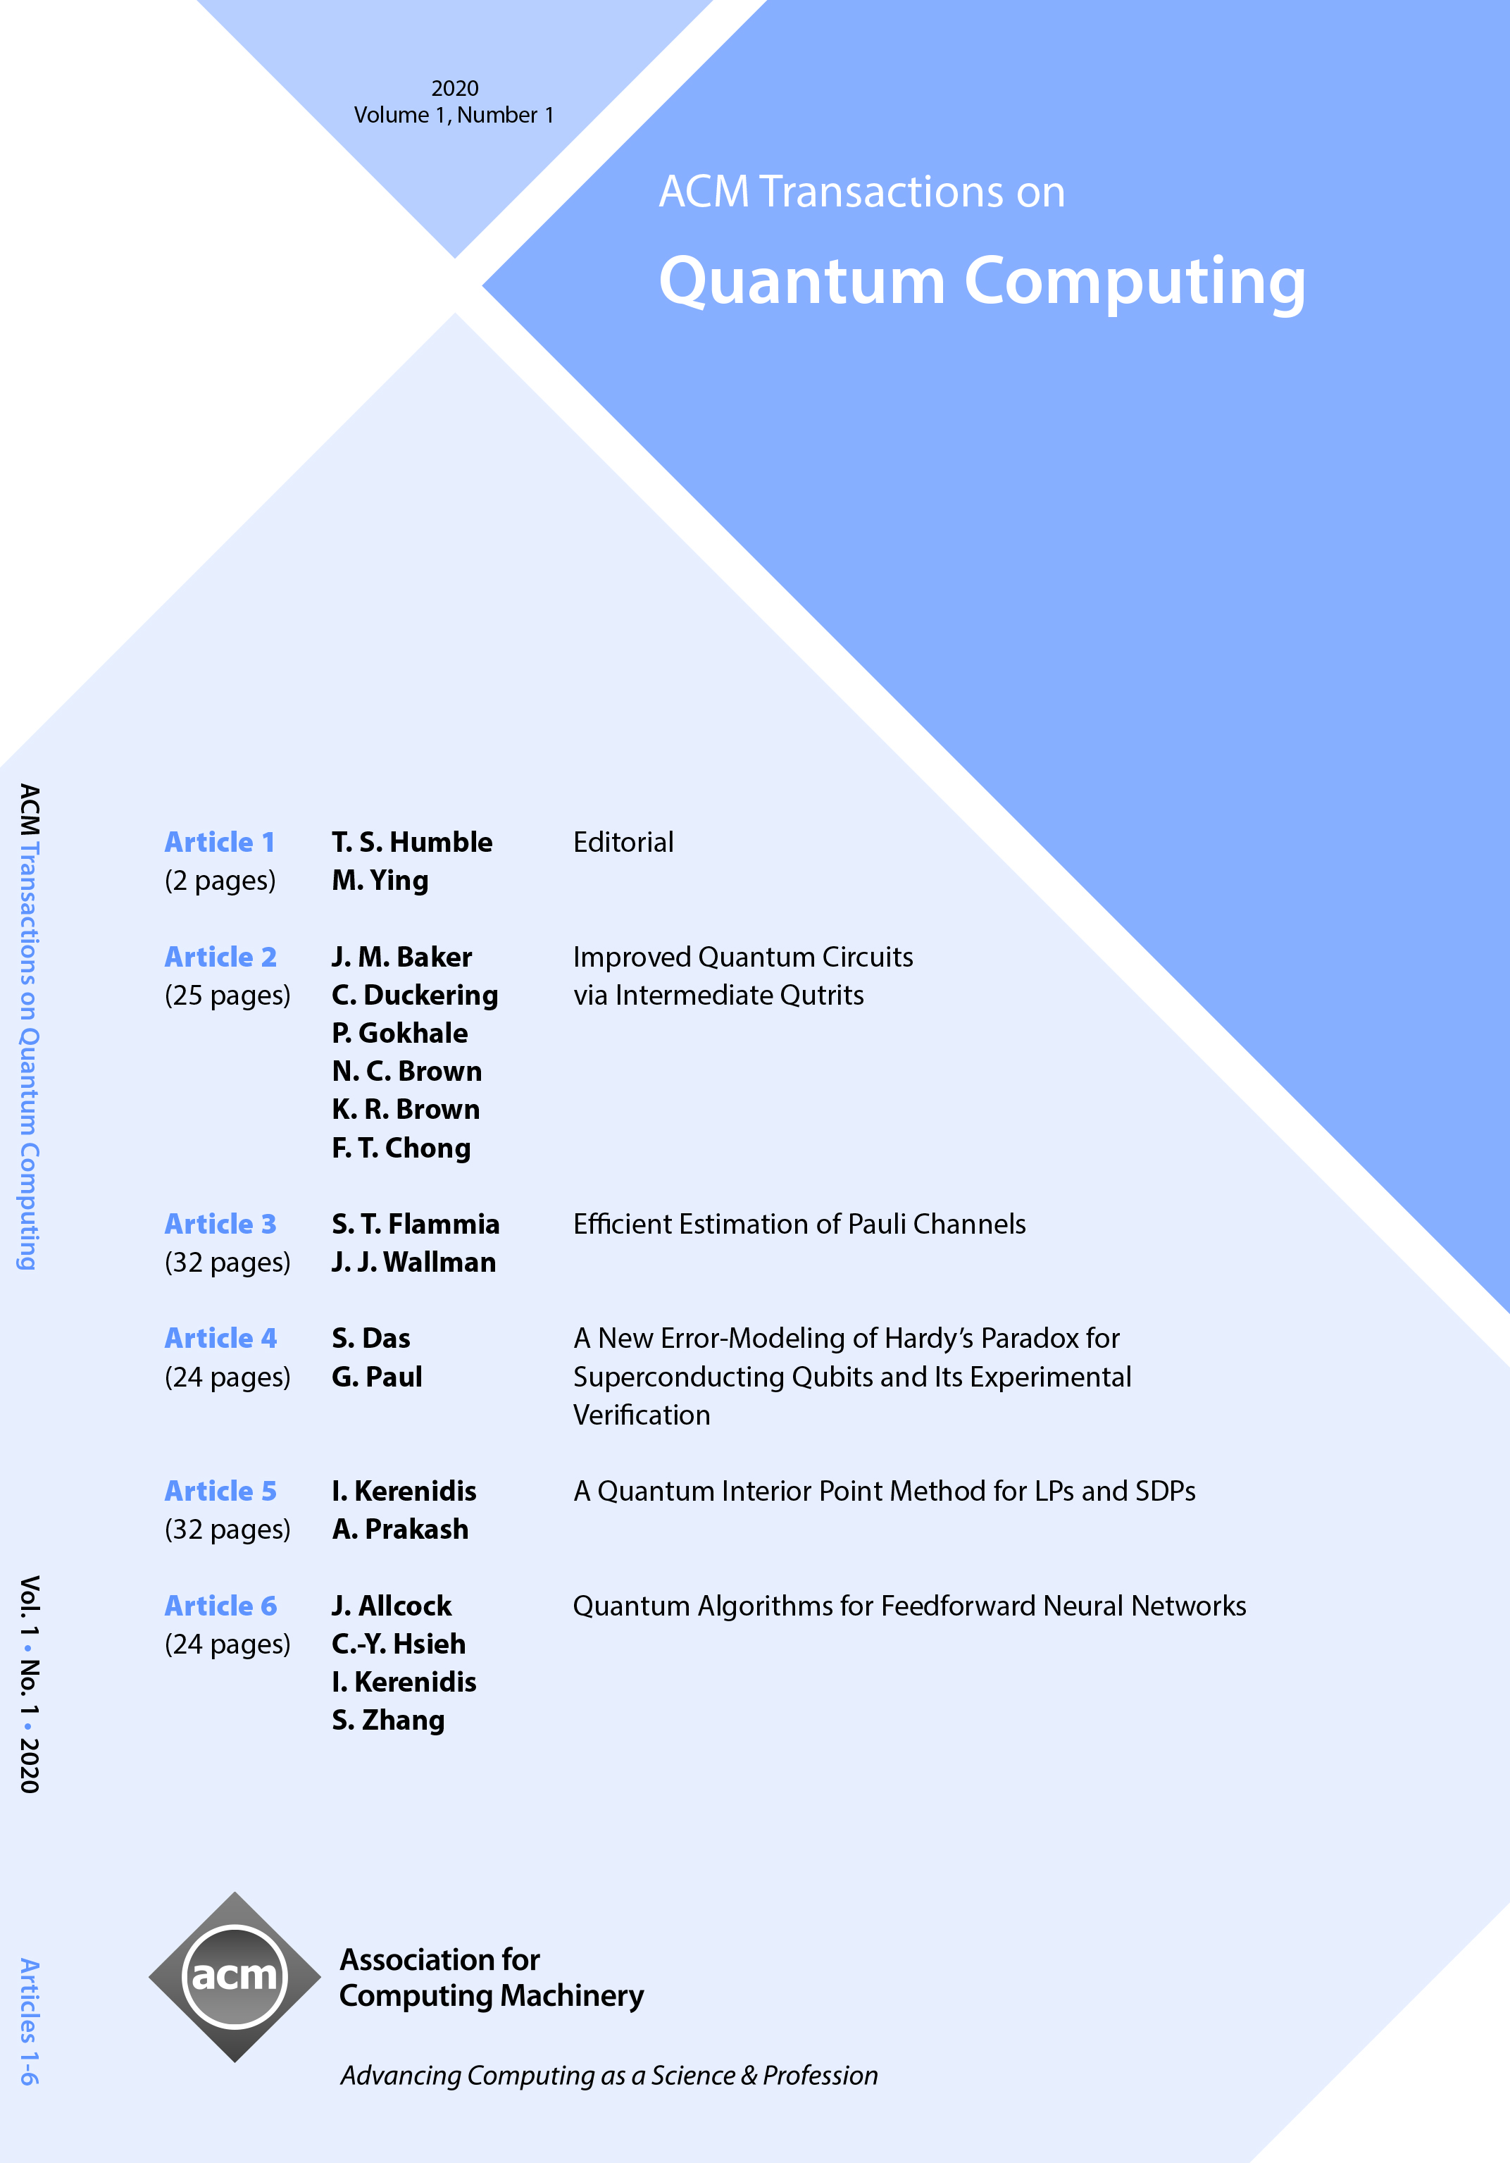

ACM Transactions on
Quantum Computing (TQC)
Co-Editors-in-Chief
Travis S. Humble, Oak Ridge National Laboratory (USA)
Mingsheng Ying, University of Technology Sydney (Australia)
ACM Transactions on Quantum Computing (TQC) publishes high-impact, original research papers and selected surveys on topics in quantum computing and quantum information science on a quarterly basis. The journal focuses on the theory and practice of quantum computing, and welcomes submissions that address computational aspects of quantum computing in particular and appeal to the broader community of quantum information science.
https://tqc.acm.org

