Slide 1

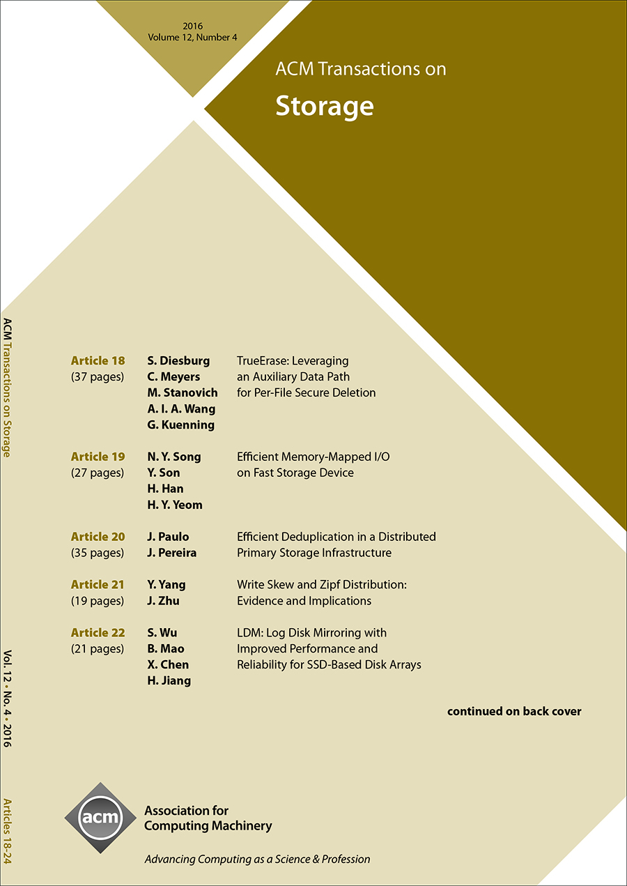

ACM Transactions on Storage (TOS)
Editor-in-Chief
Erez Zadok
Stony Brook University, USA
ACM Transactions on Storage (TOS) is the premier journal for publishing advancements in storage research and practice. The field of storage is one of the cornerstones for data availability. Storage is a broad and multidisciplinary area that comprises network protocols, resource management, data backup, replication, recovery, devices, security, theory of data coding, densities, and energy-efficiency. TOS seeks to fill an important void as a peer-reviewed comprehensive journal focused on storage.
https://tos.acm.org

